Slide 1

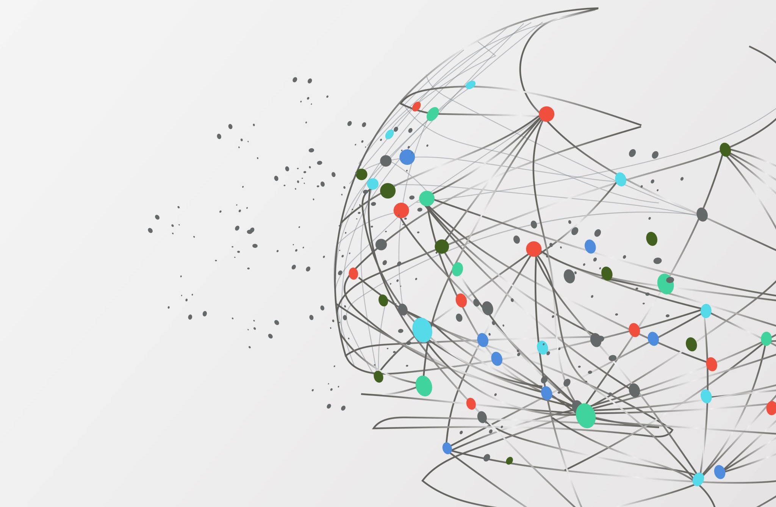
Cyber Security Breaches in USA
Damuluri Manikanta
Project-5

Slide 2

Introduction:
Cybersecurity breaches have become an increasing concern for individuals and organizations worldwide. In the United States, there have been numerous cyber attacks targeting a variety of entities, ranging from small businesses to government agencies. In this analysis, we will focus on cybersecurity breaches in the USA from 1997 to 2014.

Slide 3
Purpose:
The purpose of this analysis is to provide an overview of cyber security breaches in the USA during this period, their purpose, top five cyber attacks, cyber review, and EDA and analysis. This analysis aims to highlight the impact of cyber attacks on organizations and individuals, as well as the importance of cybersecurity measures in today's digital landscape.

Slide 4
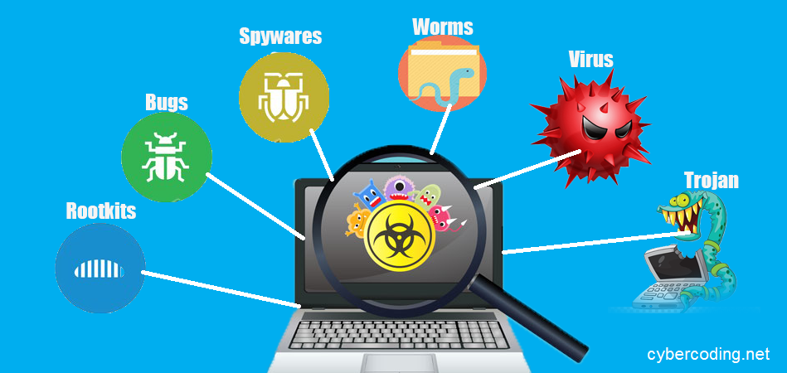
Cyber Attacks:
The cyber attacks during this period ranged from simple password guessing to highly sophisticated attacks targeting large corporations and government agencies. The attackers used a variety of methods such as hacking, phishing, and malware to gain unauthorized access to sensitive data and systems.

Slide 5
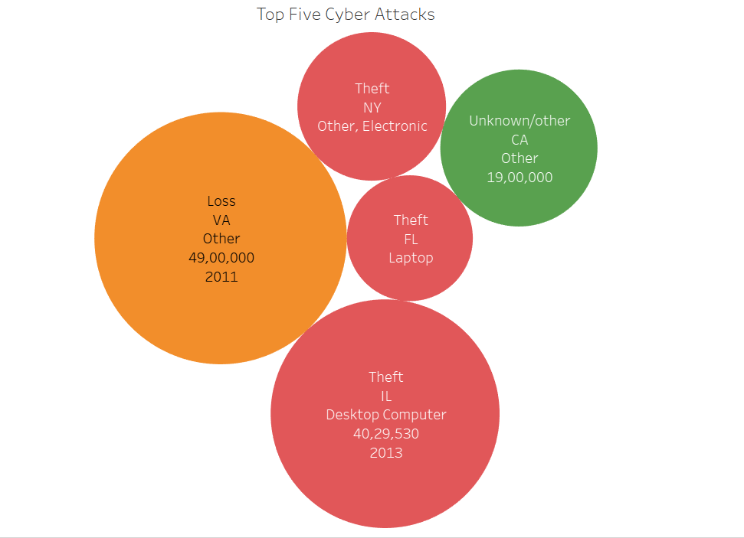
Top Five Cyber Attacks:
Some of the top cyber attacks during this period
Type of Breach –Loss in 2011(Virginia state) by this 49,00,000 individuals are affected
Type of Breach- Theft in 2013(Illinois state) by this 40,29,530 individuals are affected
Type of Breach-Unknown/Other in 2011( California state) by this 19,00,000 individuals are affected
Type of Breach Theft in 2010(New York state) by this 17,00,000 individuals are affected
Type of Breach Theft in 2009(Florida state) by this 12,20,000 individuals are affected.

Slide 6
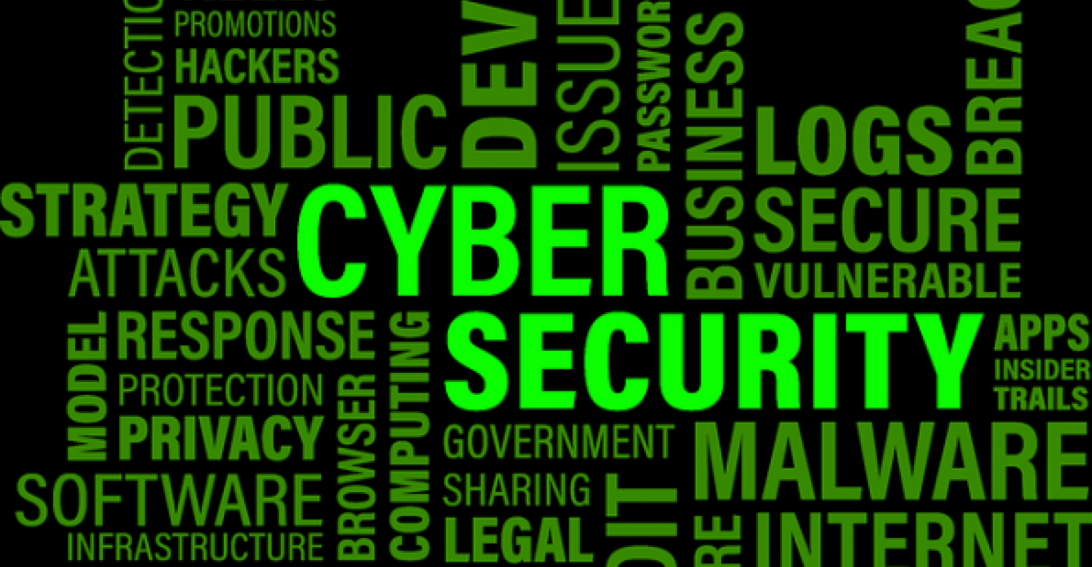
Cyber Review:
In response to the increasing frequency and severity of cyber attacks, the US government has implemented various initiatives and regulations to improve cybersecurity. Some of these include the Federal Information Security Management Act (FISMA), the Cybersecurity Information Sharing Act (CISA), and the National Institute of Standards and Technology (NIST) Cybersecurity Framework.

Slide 7
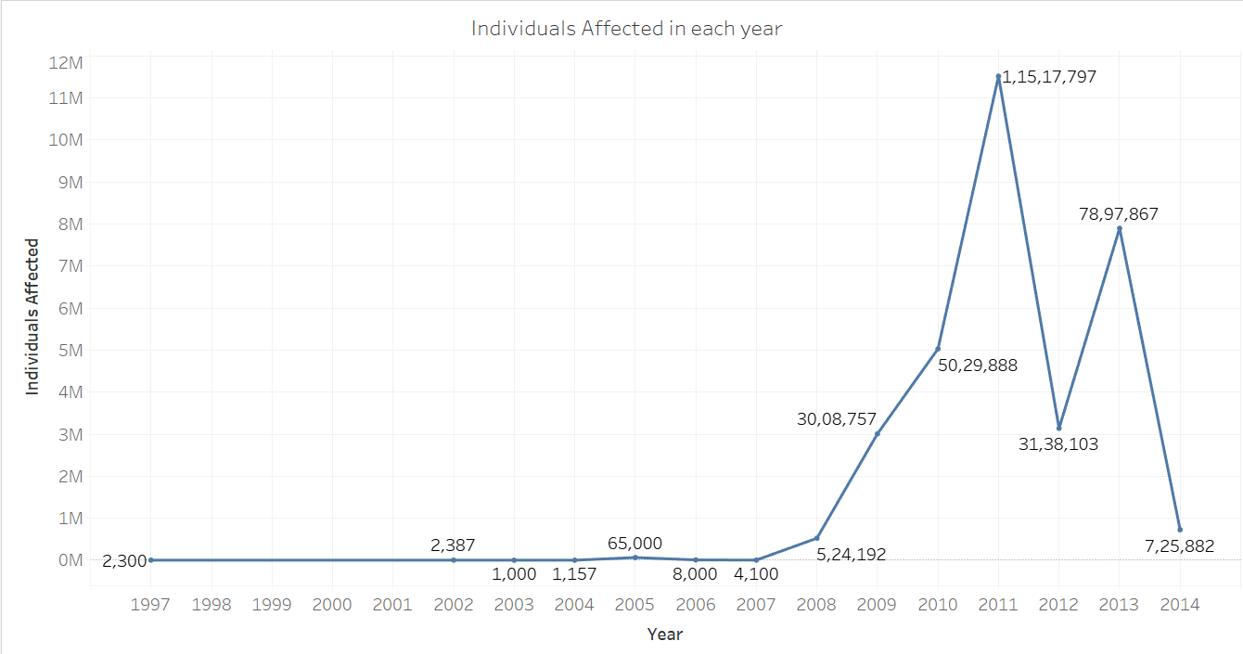
EDA and Analysis:
Through exploratory data analysis, it is clear that cyber attacks have increased in frequency and sophistication over the years, targeting a wide range of organizations and individuals. The financial sector, healthcare sector, and government agencies have been particularly vulnerable to these attacks. The cost of cybercrime is also substantial

Slide 8
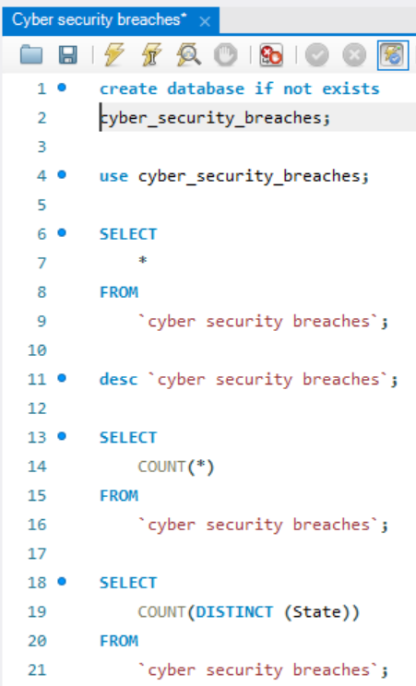
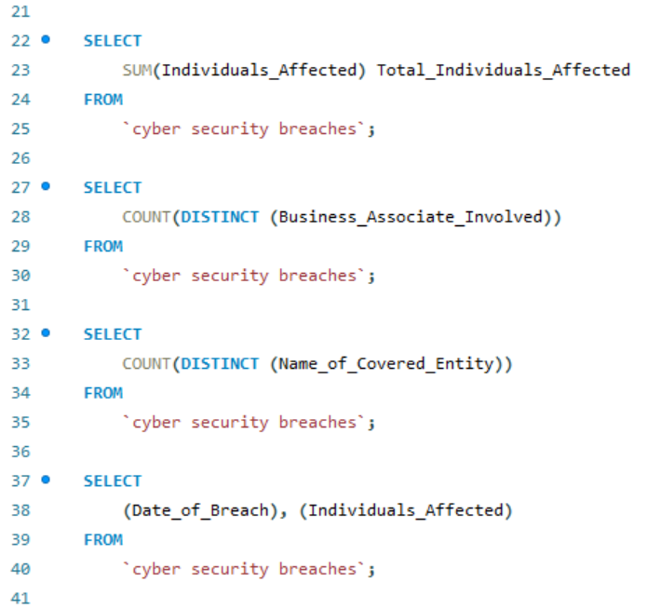
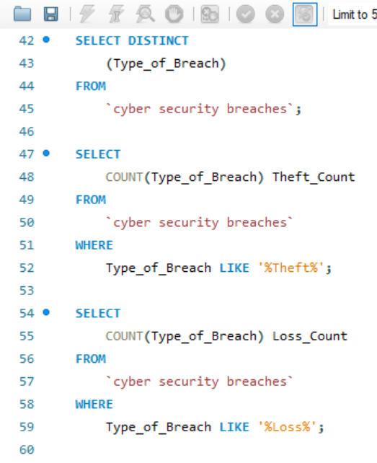

Slide 9
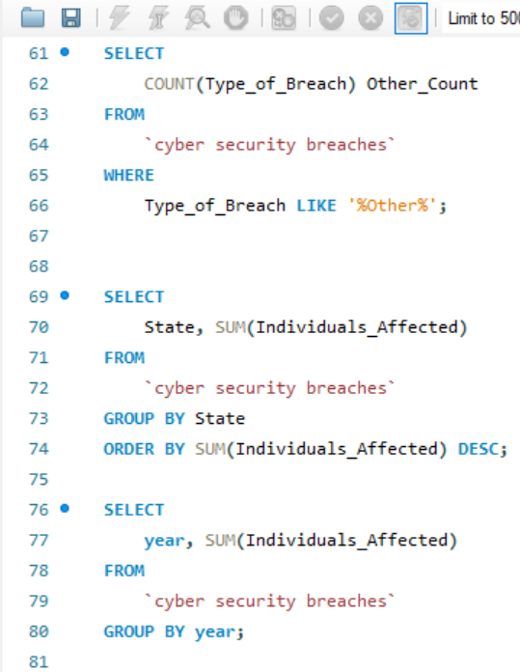
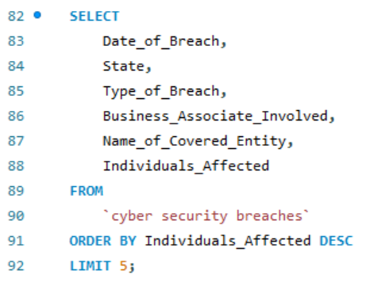
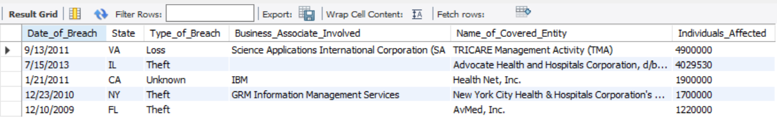

Slide 10
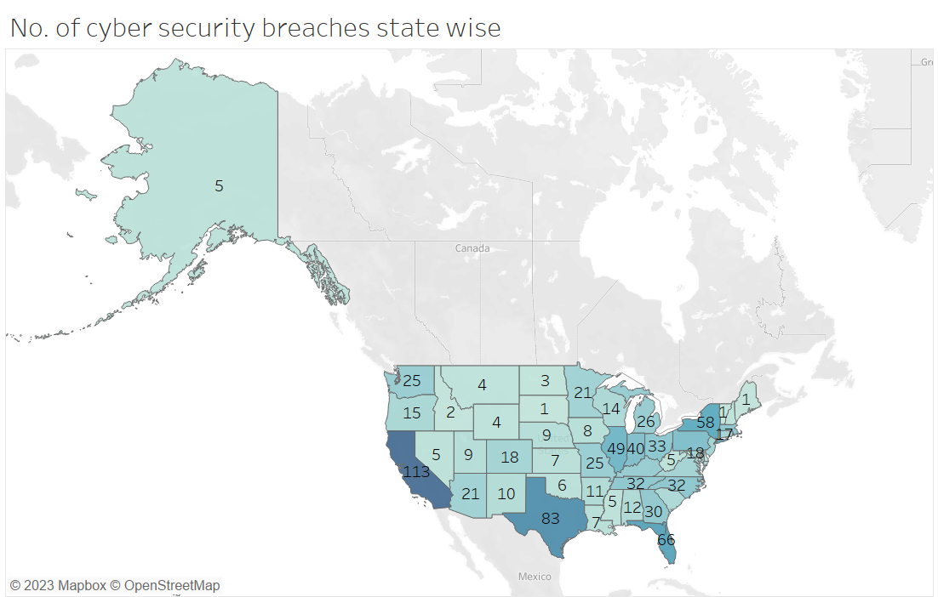

Slide 11
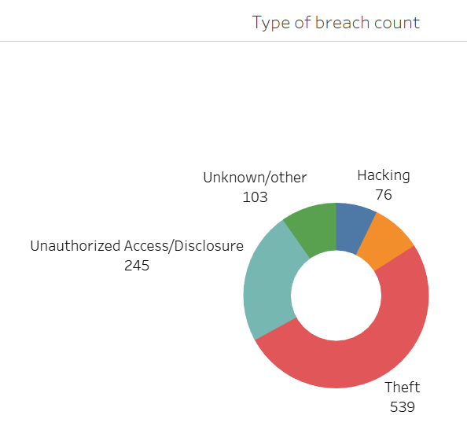
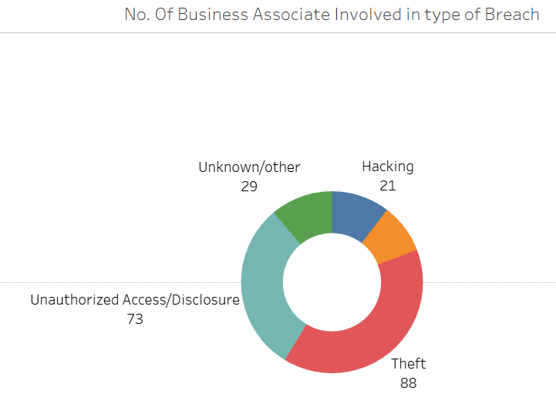
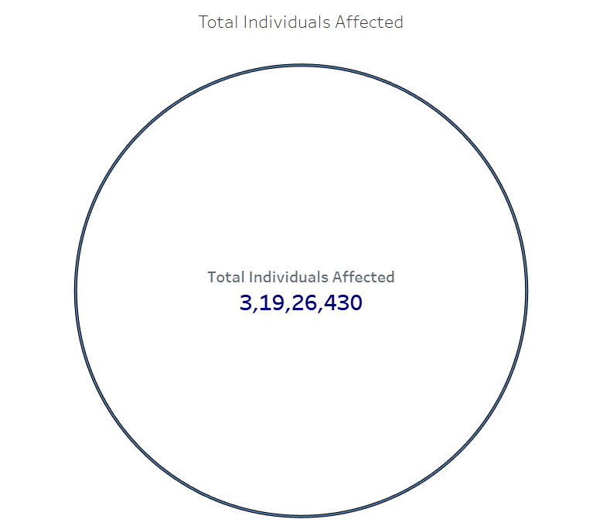
Type of Breach Count
No. of Business Associates involved in type of Breach
Total Individuals Affected

Slide 12
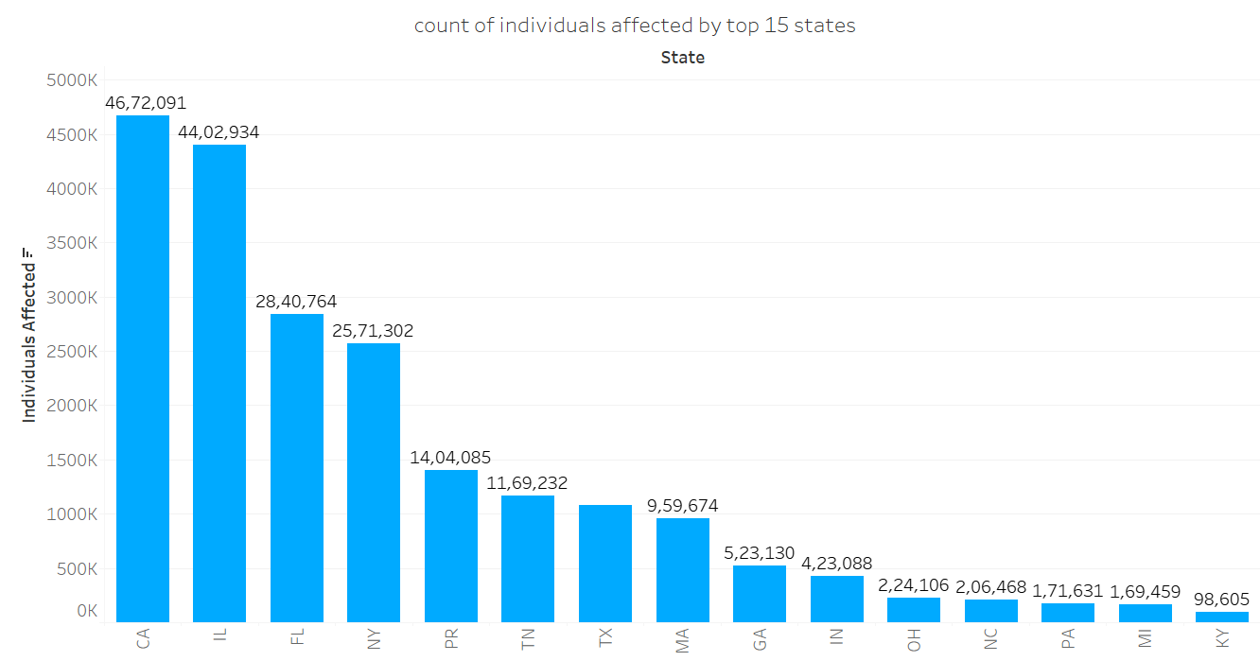

Slide 13
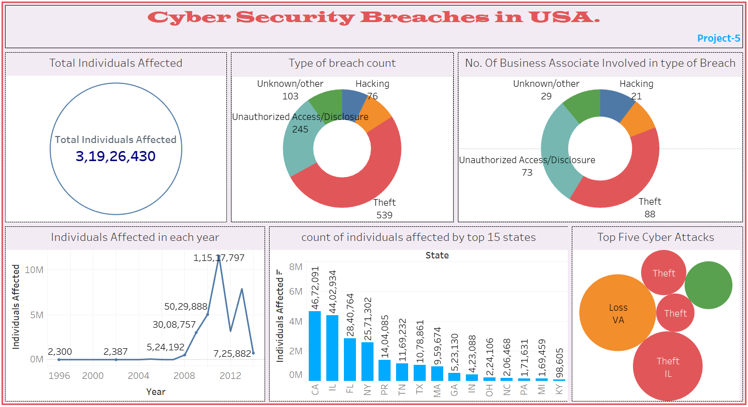

Slide 14

Conclusion:
Cybersecurity breaches in the USA from 1997 to 2014 have demonstrated the significant impact of cyber attacks on businesses and individuals. Organizations must take proactive measures to secure their systems and data, and individuals must be vigilant in protecting their personal information. The government must continue to implement regulations and initiatives to improve cybersecurity and protect the country's critical infrastructure.

Slide 15


